Slide 1
Course Code:CSC402A Course Title: Web Architecture and Application Development
Course Leader:
Kishore S.M.
kishore.cs.et@msruas.ac.in

Slide 2
Objectives
After completing this lecture, the student will be able to
Describe the features of Multitier java applications
Analyze java containers, servlets and JSP

Slide 3
Contents
Multitier java applications
JSP
Containers

Slide 4
The Application Client Container
The application client container is the interface between Java EE application clients (special Java SE applications that use Java EE server components) and the Java EE server
Runs on the client machine
The gateway between the client application and the Java EE server components that the client uses

Slide 5
Java in Enterprise Computing
Java technology is both a programming language and a platform
The Java programming language is a high-level object-oriented language that has a particular syntax and style
A Java platform is a particular environment in which Java programming language applications run
Three platforms
Java Platform, Standard Edition (Java SE)
Java Platform, Enterprise Edition (Java EE)
Java Platform, Micro Edition (Java ME)

Slide 6
Multi-Tiered Applications
Typically, multi-tiered applications have a
client tier
middle tier
data tier (often called the enterprise information systems tier)
The client tier - consists of a client program that makes requests to the middle tier
The middle tier - divided into a web tier and a business tier, which handle client requests and process application data
Data tier - permanent data store

Slide 7
Multi-Tiered Applications contd.
Client-tier components run on the client machine
Web-tier components run on the Java EE server
Business-tier components run on the Java EE server
Enterprise information system (EIS)-tier software runs on the EIS server
Java EE application development concentrates on the middle tier to make enterprise application management easier, more robust, and more secure

Slide 8
The Client Tier
The client tier consists of application clients that access a Java EE server
They are usually located on a different machine from the server
The clients make requests to the server
The server processes the requests and returns a response back to the client
Many different types of applications can be Java EE clients, and they are not always, or even often Java applications
Clients can be a
Web browser
Standalone application
Other servers

Slide 9
The Web Tier
The web tier consists of components that handle the interaction between clients and the business tier
Its primary tasks
Dynamically generate content in various formats for the client
Collect input from users of the client interface and return appropriate results from the components in the business tier
Control the flow of screens or pages on the client
Maintain the state of data for a user's session
Perform some basic logic and hold some data temporarily in JavaBeans components

Slide 10
Java EE Technologies Used in the Web Tier
Servlets
Java programming language classes that dynamically process requests and construct responses, usually for HTML pages
Java Server Pages (JSP)
Text-based documents that are compiled into servlets and define how dynamic content can be added to static pages, such as HTML pages
Java Beans Components
Objects that act as temporary data stores for the pages of an application

Slide 11
The Business Tier
Consists of components that provide the business logic for an application
Business logic is code that provides functionality to a particular business domain, like the financial industry, or an e-commerce site
In a properly designed enterprise application, the core functionality exists in the business tier components

Slide 12
Java EE Technologies Used in the Business Tier
Enterprise JavaBeans (enterprise bean) components
JAX-RS RESTful web services
Java Persistence API entities

Slide 13
The Enterprise Information Systems Tier
The Enterprise Information Systems (EIS) tier consists of
Database servers
Enterprise resource planning systems
Other legacy data sources, like mainframes
These resources typically are located on a separate machine than the Java EE server
Accessed by components on the business tier

Slide 14
Java EE Technologies Used in the EIS Tier
The Java Database Connectivity API (JDBC)
The Java Persistence API
The Java EE Connector Architecture
The Java Transaction API (JTA)

Slide 15
Java EE Clients
Java EE client is usually
A web client
An application client
Web Clients
A web client consists of two parts:
Dynamic web pages containing various types of markup language (HTML, XML, and so on), which are generated by web components running in the web tier
A web browser, which renders the pages received from the server
A web client is sometimes called a thin client
Thin clients usually do not query databases, execute complex business rules, or connect to legacy applications

Slide 16
Java EE Clients contd.
Application Clients
Runs on a client machine and provides a way for users to handle tasks that require a richer user interface
Typically has a graphical user interface (GUI) created from the Swing or the Abstract Window Toolkit (AWT) API, but a command-line interface is certainly possible
Directly access enterprise beans running in the business tier
Can open an HTTP connection to establish communication with a servlet running in the web tier

Slide 17
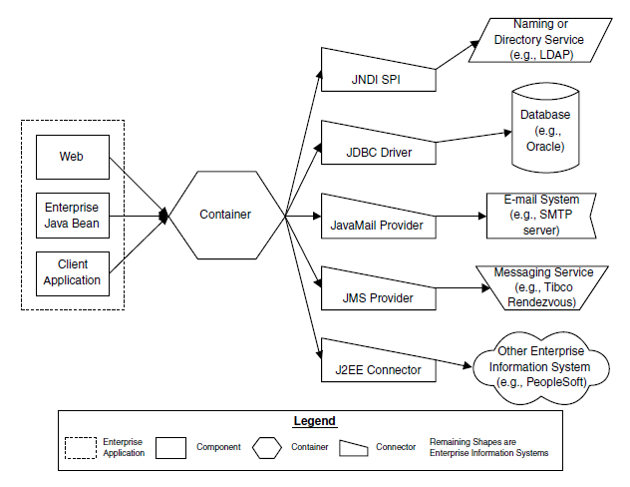
Java EE Architecture

Slide 18
Components
An individual Java object (class or JSP) or an archive of related Java objects
Fundamental building blocks for Java EE
Web components such as JSPs, Servlets, or Web Archives
EJB components, which are Java Archives containing EJB code and the deployment descriptor
Client applications, which are stand-alone Java executables

Slide 19
Archives
A package of Java code that contains one or more specific descriptors and a manifest
Deployment descriptors are the heart of the Java EE packaging specification
Descriptors
Provide configuration information, environment settings, role-based security, and vendor-specific information
The manifest
A packing slip that is automatically generated by the archive process

Slide 20
Types of Archives
Three types of archives
Java Archives (JAR)
Encapsulates one or more Java classes, a manifest, and a descriptor
JAR files are used in Java EE for packaging EJBs and client-side Java Applications
Web Archives (WAR)
Similar to JAR files, except that they are specifically for web applications made from Servlets, JSPs, and supporting classes
Enterprise Archives (EAR)
Contains all of the components that make up a particular Java EE application

Slide 21
Containers
An independent application that creates an environment for components
The container provides several key functions
Life cycle management for components
The container instantiates new instances of a component and cleans up when the component dies
Environment configuration
The container provides configuration information and the framework for the components
Resources
Provides access to enterprise information systems such as databases, naming and directory services, and e-mail systems
This access is managed through connectors

Slide 22
Java Servlets and JSP Pages
Server-side Java components
Reside in the JEE Web Tier
Dynamic Web content generation
Servlets are better suited to application flow control
JSPs are better suited to the building of interface and display components
22

Slide 23
Summary
Container is an independent application that creates an environment for components
JSP pages are HTML pages with embedded Java

